Slide 1
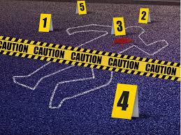
Forensic Science Club
Advisor: Ms. Baker
Location: D5

Slide 2
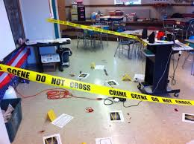
What do we do in
Forensic Science Club?
Our primary purpose is to provide our student members with the opportunity to participate in activities pertaining to science and law in order to help students prepare for a career in forensic science.
Group's principal activities, events, or programs:
Guest speakers in the field of forensics, mock crime
science, Murder Mystery Dinners, information
on student jobs and internships in the field, field trips and attend conferences and symposiums.

Slide 3
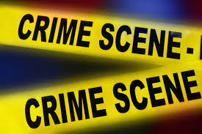
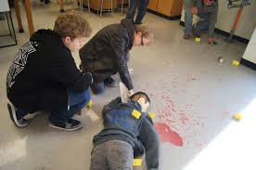
In addition to hosting Murder Mystery Dinners, we investigate case studies on Serial Murders, How to identify and analyze evidence and disucss cold cases.
COME JOIN US !! Club meeting dates are Wednesdays in D5

